Slide 1
A Mindful Path to Decrease Trauma Intrusions: Utility and Implications of Present Moment Awareness
Andrew M. Sherrill, M.A.
Christine E. Valdez, M.A.
Michelle M. Lilly, Ph.D.
June 22, 2014
Notes:
Abstract:
Third-wave approaches to PTSD treatment emphasize “being present” to increase psychological flexibility (Follette et al., 2006). However, researchers have struggled to measure present moment awareness (PMA; i.e., shifting attention to what is happening here and now; Fletcher & Hayes, 2005), and assess its clinical utility. Women with victimization histories were assigned to either a “concrete rumination” or a control condition (see Watkins et al., 2008). After manipulation, participants recalled their trauma, and then wrote down whatever information was present in their awareness (see Cacioppo et al., 1997). PMA was measured in a novel way by coding shifts in attention (e.g., sounds in the environment, interoceptive sensations) within these written protocols. In concrete ruminators, PMA was inversely related to trauma intrusions during written protocols and positively related to positive affectivity. In controls, PMA was unrelated to trauma intrusions and positively related to negative affectivity. Methodological and theoretical implications will be discussed.
Educational Objective:
Describe and assess the clinical utility of present moment awareness in posttraumatic stress symptomatology.

Slide 2
What is “mindfulness?”
Two Components (Bishop et al., 2004)
Awareness of present experiences
Acceptance of present experiences
Research question
What happens when these two components are de-coupled?

Slide 3
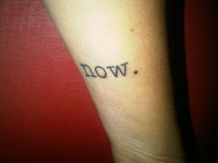
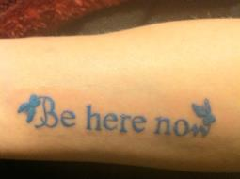
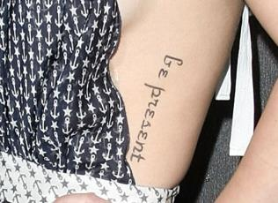
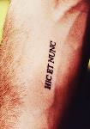
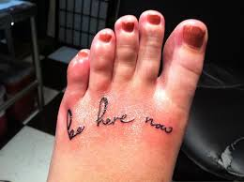
Notes:
One way to gauge pop culture to read people’s tattoos. Here are some examples of people who have decided to eternally remind themselves to “be here now” or “commit to the present.”
The message is out that present moment awareness is important. But what about the other message? Where are the reminders to accept the here-and-now, regardless of what the situation has in store?

Slide 4
Dismantling Mindfulness
Present Moment
Awareness
Mindfulness Processes
Acceptance
Values Clarification
Psychological Flexibility
Defusion
Committed Action
Self-as-Context

Slide 5
Present Moment Awareness (PMA)
Synonyms within Contextual Behavioral Science
Contact with the Present Moment (Hayes et al., 1999)
Self-as-Process (Foody et al., 2012)
Definitions
Shifting attention to what is happening here-and-now (Fletcher & Hayes, 2005)
Discriminating features of the environment (Blackledge & Drake, 2013)

Slide 6
Present Moment Awareness in Isolation
Empirical question
When isolated from other mindfulness processes, is present moment aware-ness inert, or does it lead to desirable outcomes or iatrogenic outcomes?
Desirable outcomes?
Extrapolation of theory (Bishop et al., 2004; Blackledge & Drake, 2013; Hayes et al., 1999)
Laboratory-based component studies
Attention training (Sharpe et al., 2010)
Breathing meditation (Arch & Craske, 2006; Feldman et al., 2010; McHugh et al., 2010)
Mindfulness exercises (Broderick, 2005; Heppner et al., 2008; May et al., 2010; Sanders & Lam, 2010)
Sensory-focused instructions (Burns, 2006; Cioffi & Holloway, 1993; Haythornthwaite et al., 2001; Logan et al., 1995; Michael & Burns, 2004)
Iatrogenic outcomes?

Slide 7
Necessary-But-Insufficient
Notes:
It may be that simply noticing the struggle might be a necessary-but-insufficient condition for psychological flexibility in the same way that simply jumping out of a airplane is a necessary-but-insufficient condition for sky-diving.

Slide 8
Measuring Present Moment Awareness
Self-report?
Task demands
Too much derivation (Blackledge & Drake, 2013)
“Yes, I was in the present a couple second ago.”
Protocol analysis?
Analyzing spoken/written statements using a theoretical framework
Objective indices of present moment awareness

Slide 9
Sensation-Shifting Coding Scheme
Definition
Flexibly observing the occurrence of internal stimuli (e.g., bodily sensations, thoughts, and feelings) and external stimuli (e.g., sounds, sights, and touch)
Operationalization
Frequency of verbally indicated shifts of attention across sensory modalities
Example:
“The clock is ticking. My arms are cold. I have to go shopping tonight. My hands is cramping while I write. The clock is still ticking.”
Visual → Thermal → Cognitive → Pain → Visual
PMA Index = #SensationShifts / #Clauses (Example = 0.8)

Slide 10
Study Design
Sample (N = 40):
Community-recruited female victims of physical and sexual assault
Prone to experience unwanted private experiences
Outcomes:
Changes in Positive and Negative Affect (PANAS-X; Watson & Clark, 1999)
Trauma Intrusions (Cacioppo et al., 1997)
Protocol also used to code PMA Index with Sensation-Shifting Coding Scheme

Slide 11
Study Design (continued)
Modes of Processing Conditions (Watkins et al., 2008)
Read and concentrate on 30 scenarios
Example:
“You have recently started a new job. Although you have tried very hard to be friendly and polite to your new colleagues, they do not make any effort to include you in conversation. Today you overhear them making arrangements to socialize after work, but they do not invite you along.”
Control condition: “Default awareness” (n = 20)
“Count the number of verbs”
Experimental condition: “Mindful awareness” (n = 20)
“Imagine in your mind as vividly and concretely as possible a ‘movie’ of how this event unfolded”
No instruction to “be aware of the present moment”

Slide 12
Predictions
Between Subjects IV
Default Awareness
Mindful Awareness
Continuous IV
PMA Index
Three DVs
Intrusion Frequency
Change in Negative Affect
Change in Positive Affect
H₀: PMA-alone is inert (no direct effect on outcomes)
H₁: PMA-alone leads to desirable outcomes
H₂: PMA-alone leads to iatrogenic outcomes
Mindful awareness:
⇧ PMA =  Negative Affect
⇧ PMA =  Positive Affect
⇧ PMA =  Trauma Intrusions
Default awareness:
⇧ PMA =  Negative Affect
⇧ PMA =  Positive Affect
⇧ PMA =  Trauma Intrusions

Slide 13
Qualitative Results: Sensation-Shifting Coding Scheme
Code | Example | Frequency
Cognitive-Emotional-Affective | “I love my brother so much.” | 2,073
Visual | “This room is clean.” | 50
Pain | “My hands hurt from writing.” | 30
Chronoceptive | “Time is going by fast.” | 20
Interoceptive | “I need to pee.” | 16
Thermoceptive | “It’s hot in here.” | 10
Auditory | “There is a lot of background noise.” | 9
Touch | “The floor is vibrating.” | 5
Proprioceptive | “This chair is uncomfortable.” | 4
Taste | “My mouth tastes bad.” | 3
Equilibrioceptive | N/A | 0
Olfactory | N/A | 0

Slide 14
Multi-Method PMA Assessment
LIWC: Linguistic Inquiry and Word Count (Pennebaker et al., 2001)
Dictionary of 2000+ into 70+ categories
Targeted category: Present-focused verbs (e.g., is, am, does, hear)
Associated with mindfulness skills (Moore & Brody, 2009)
Associated with trauma narratives (Jelinek et al., 2010)
Convergence between PMA Indices
Significant correlation: r(78) = .258, p = .021

Slide 15
Results
Default awareness:
⇧ PMA =  Negative Affect [r(18) = .543, p = .013]
⇧ PMA =  Positive Affect [r(18) = -.399, p = .081]
⇧ PMA = ⬄ Trauma Intrusions [ß = -.21, t(17) = -0.78, p = .448]
Mindful awareness:
⇧ PMA = ⬄ Negative Affect [r(18) = .065, p = .786]
⇧ PMA =  Positive Affect [r(18) = .602, p = .006]
⇧ PMA =  Trauma Intrusions [ß = -.58, t(17) = -2.24, p = .039]

Slide 16
Discussion
State of current research
Dismantling mindfulness: mechanistic and functional
Different methods, different results
Present-moment awareness: necessary-but-insufficient condition?
Being present ≠ acceptance
Unsuccessful avoidance can occur in the here-and-how
Future research and methodological implications
Mediational research
Protocol analyses
Sensation-shifting coding scheme
Pennebaker’s LIWC
Notes:
Mindfulness is often viewed as having multiple components. By dismantling the components we can better understand our active ingredients. This is not just a mechanistic goal. By better understanding the function of these components, and how the components interact, our interventions will be better informed. The empirical literature on present moment awareness is small and is typically approached by inducing present moment awareness through some type of mindfulness exercise. These studies show that present moment awareness may reduce aversive experiences and promote values-consistent behavior, but these studies don’t truly isolate present moment awareness because many processes can be engendered by the types of manipulations that are used. In this study, we developed a new protocol analysis based on a contextual behavioral definition of present moment awareness in order to specifically measure this process as it unfolds. Using this approach, we found some novel findings.
You can sum the findings by stating the present moment awareness may be a necessary-but-insufficient condition for mindfulness. Being present does not entail that acceptance comes along for the ride. For clinicians, this may be a very important caveat as acceptance, defusion, and self-as-context can be much more difficult skills to develop, and therefore should not be minimized. It maybe unhelpful and perhaps unhealthy to isolate present moment awareness from other mindfulness components – that is, the qualities of observing without judgment and elaboration or attempts to control and change. So, this data tempers the glorifying of the present moment by suggesting that “being present” is one quality of awareness that is not unique to mindfulness but also aversive experiences. By definition, unsuccessful avoidance can occur in the here-and-how. When you return to the experience you are trying to avoid, you are returning to the present moment.
It might not be surprising to find that a component of the psychological flexibility model becomes inert when isolated from the other components. These components have always been viewed as transactional processes. In fact, these data show that the processes interact. However, it is one thing to say that components interact and another to say how components interact. More mediational work is needed on these processes to determine how active ingredients are best combined. In order to accomplish this objective, reliable and valid measures are needed for each therapeutic process. These data show that one promising approach may be protocol analyses, either using our new sensation-shifting coding scheme or Pennebaker’s LIWC program.

Slide 17
Notes:
I’d like to conclude with some tattoo advice. Earlier, I showed you all these pictures of people who tattooed “be here now” on their body. They clearly got the first message about mindfulness. The second message is to engage in experiential acceptance. One thing I notice about these tattoos is that they are all attractive. They seem to say, “be here now” so long as “now” is pretty and acceptable.

Slide 18
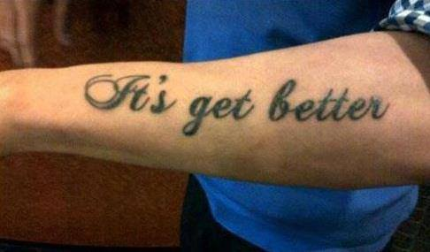
Conclusion: Tattoo Advice
Correction: “It gets better”
Notes:
Based on our findings, my tattoo advice is to not just remind yourself to “be present.” My advice is to also practice and remind yourself to be accepting of the present moment, whatever it affords. To achieve this outcome, I’d recommend you ask your tattoo artist to make a glaring spelling or grammatical error in your inspirational tattoo. Each time you look at it, you’ll experience a great deal of embarrassment and, in doing so, you’ll have the opportunity to be present and also practice acceptance.

Slide 19
The End

